Slide 1
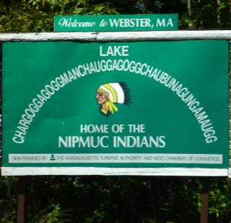
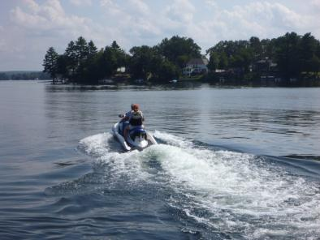
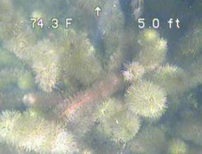
Webster Lake Plant Survey 2012
Ken Wagner, Ph.D., CLM and Maxine Verteramo
Water Resource Services, Inc.

Slide 2
Plant Data
11 of 40 species dominant in 2003; not fanwort

Slide 3
Rooted Aquatic Plants
2003 survey of 84 points summarized into biomass ratings (also did cover).
Provides impression of nuisance potential

Slide 4
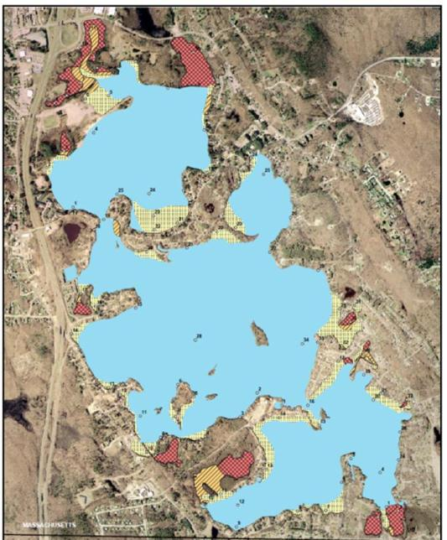
Plants in 2003
Distribution of plants in 2003 includes sparse to no plants (blue), moderate density (yellowish), dense (orangish) and very dense (reddish) areas
Largely in coves and along shore

Slide 5
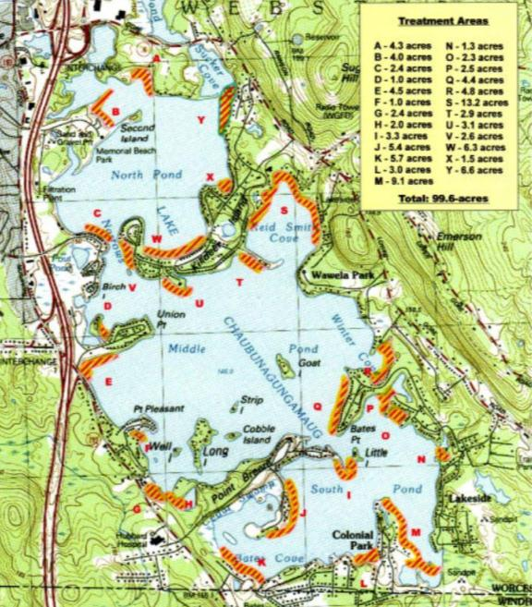
2008 treatment
By 2008, had established treatment areas to be considered on annual basis.
Also have no treatment (habitat) areas

Slide 6
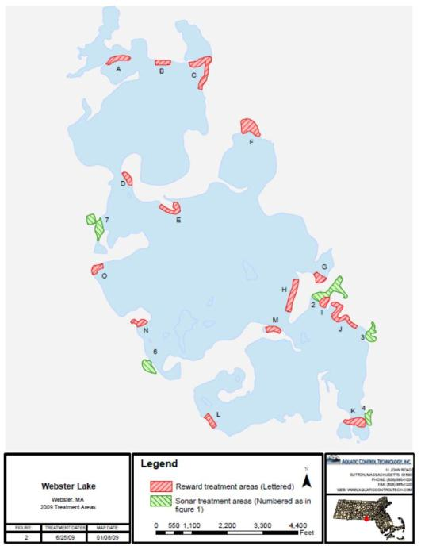
2009 Treatment
Annual program includes Reward (diquat) and Sonar (fluridone) herbicide applications and physical controls such as hydroraking.
Treatment based on need and budget

Slide 7
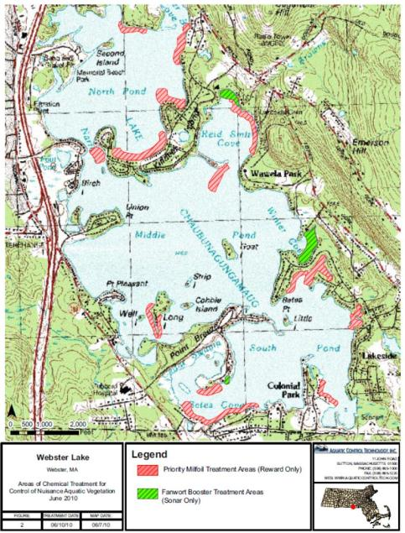
2010 Treatment
Same approach as in 2008, but some differences in areas treated

Slide 8
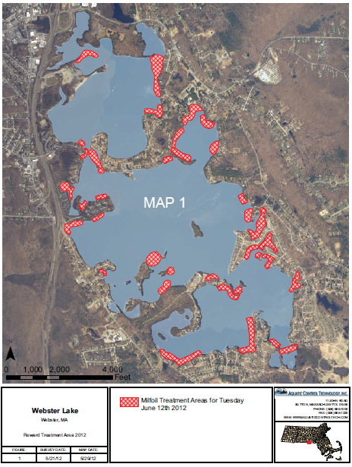
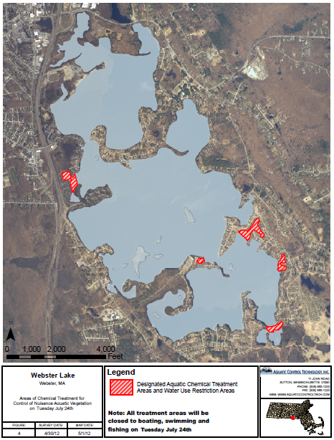
2012 Treatments

Slide 9
2011 Plant Related Conclusions
The lake is too large to do a thorough plant survey every year; area targeted surveys inform treatment decisions, but don’t facilitate quantitative evaluation of results
It appears that plant nuisances have been reduced, but are not eliminated
Eurasian watermilfoil is now non-dominant, but fanwort has risen in dominance over 8 years; variable watermilfoil continues as a dominant invasive species
A once-per-decade thorough survey might allow assessment of longer term trends

Slide 10
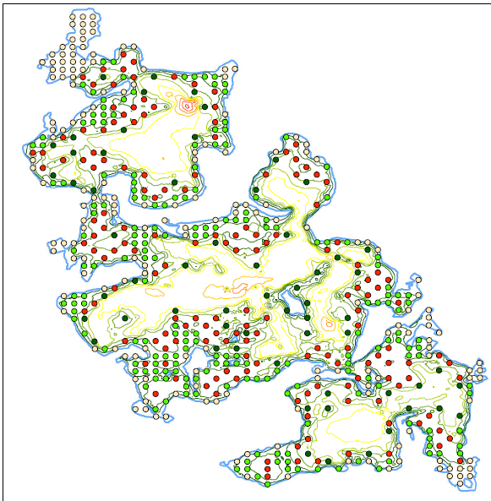
2012 Survey
584 points
4 depth intervals
1 point per acre
All points <10 ft deep surveyed
½ points 11-15 ft deep
1/3 points 16-20 ft deep

Slide 11
Plant Types
35 species in 2003
32 species in 2012
44 species total
Some ID issues
Some relative abundance changes
Only about 8-12 common species

Slide 12
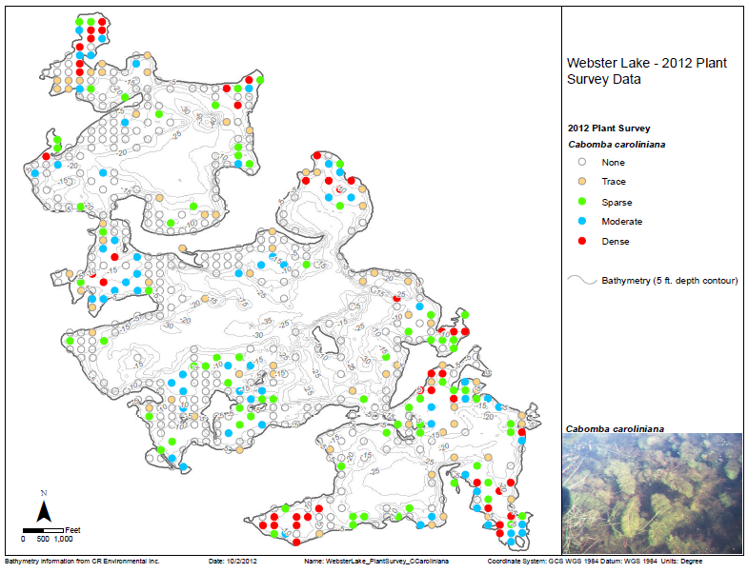
Fanwort distribution

Slide 13
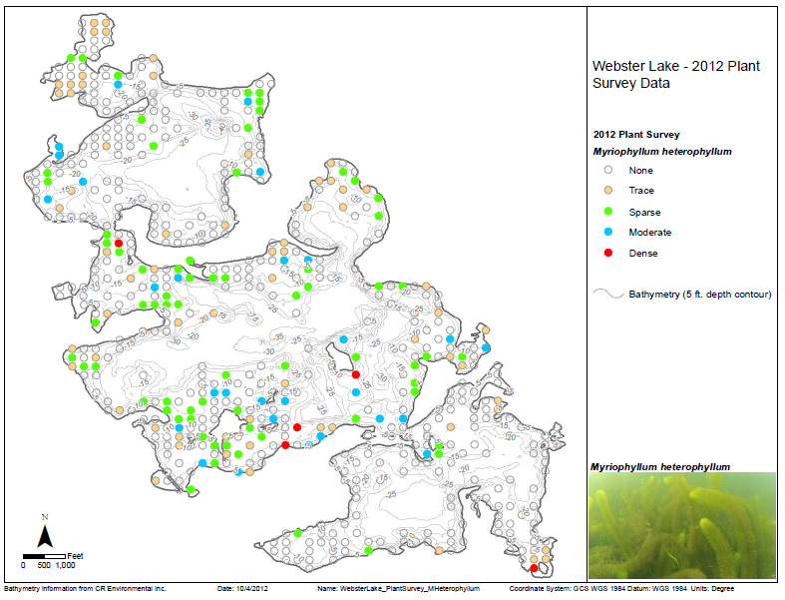
Variable milfoil distribution

Slide 14
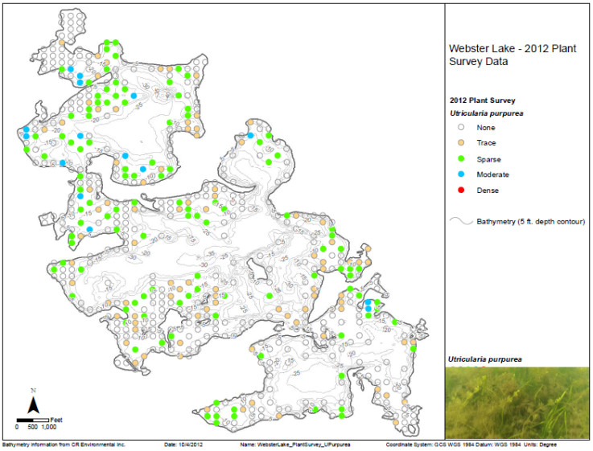
Purple bladderwort distribution

Slide 15
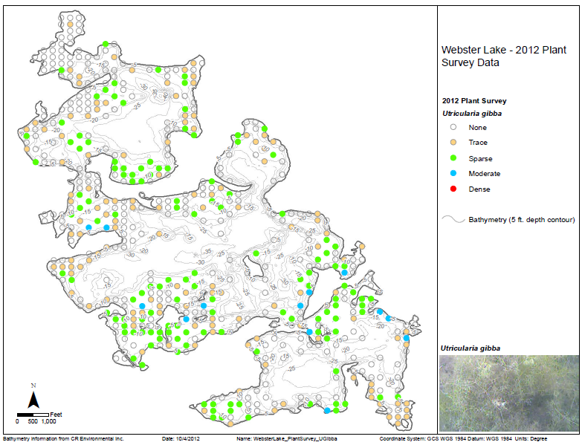
Fine bladderwort distribution

Slide 16
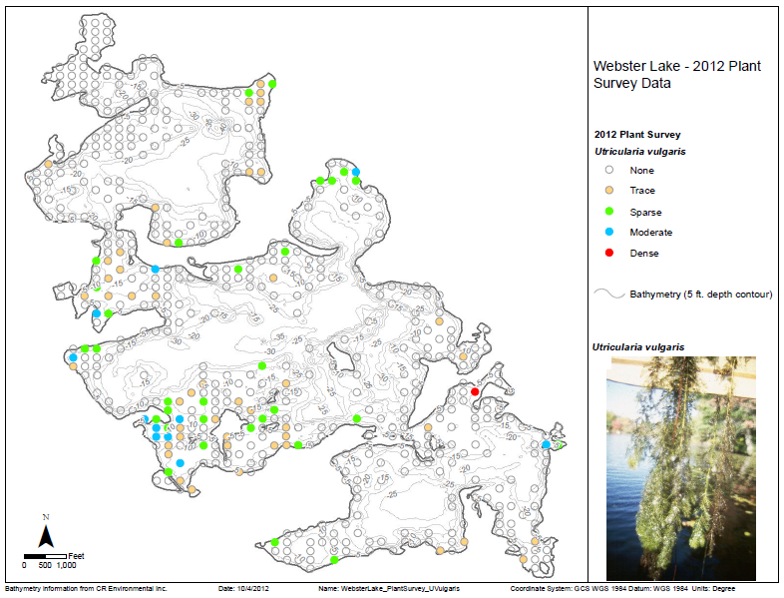
Coarse bladderwort distribution

Slide 17
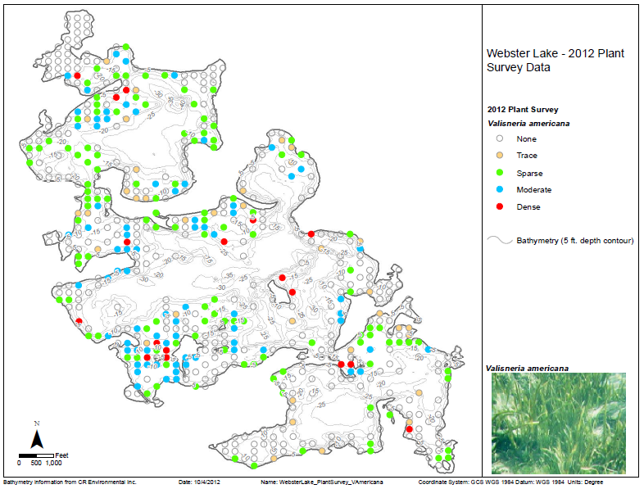
Water celery distribution

Slide 18
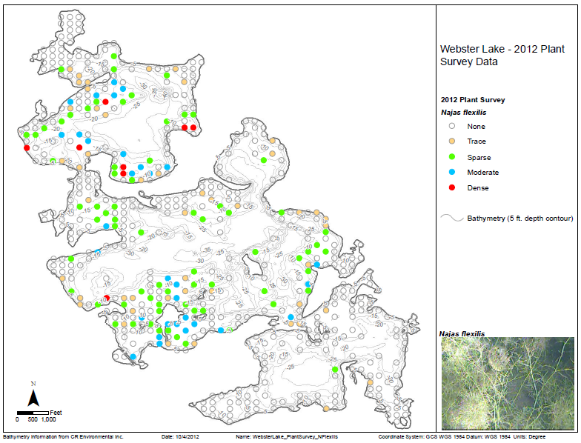
Bushy naiad distribution

Slide 19
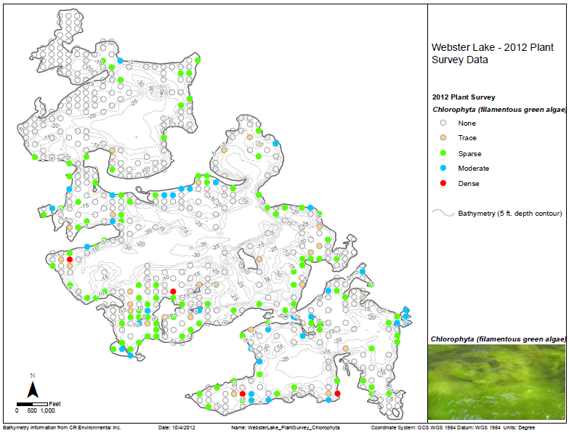
Filamentous green algae distribution

Slide 20
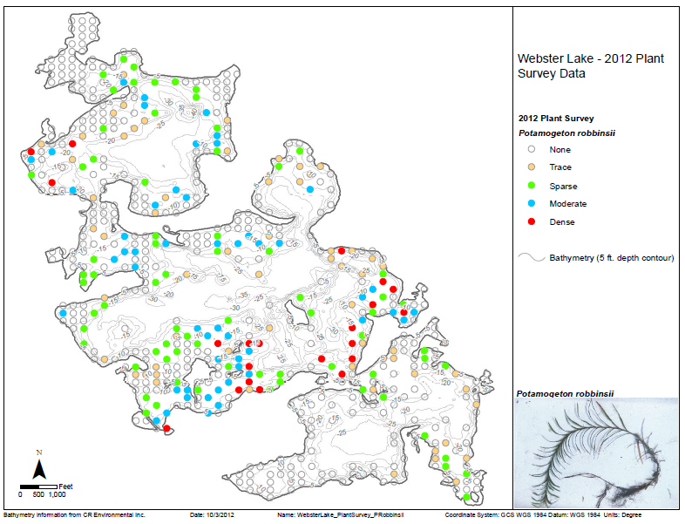
Robbins’ pondweed distribution

Slide 21
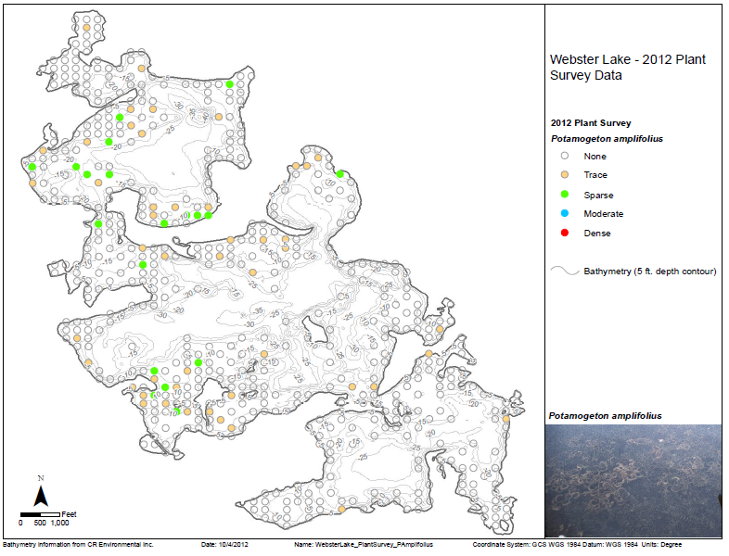
Bigleaf pondweed distribution

Slide 22
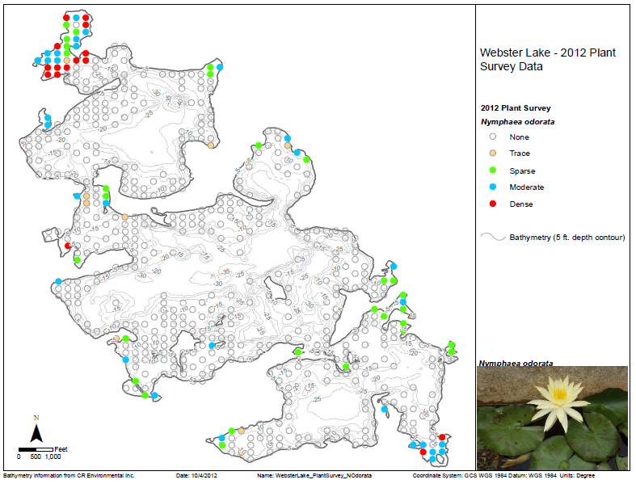
White water lily distribution

Slide 23
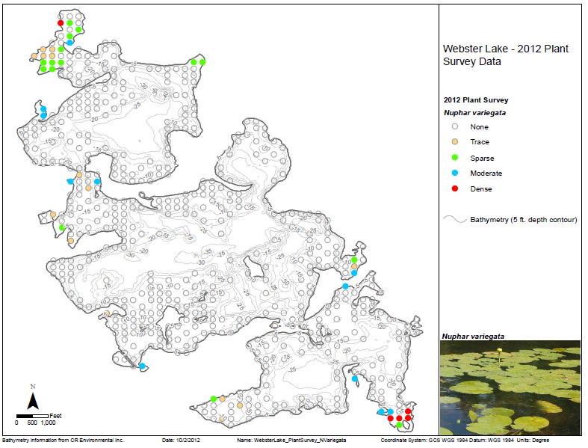
Yellow water lily distribution

Slide 24
Fanwort over depth

Slide 25
Variable milfoil over depth

Slide 26
Purple bladderwort over depth

Slide 27
Water celery over depth

Slide 28
Robbins pondweed over depth

Slide 29
Fanwort over substrate

Slide 30
Variable milfoil over substrate

Slide 31
Purple bladderwort over substrate

Slide 32
Water celery over substrate

Slide 33
Robbins’ pondweed over substrate

Slide 34
Cover around the lake

Slide 35
Cover around the lake

Slide 36
Biovolume around the lake

Slide 37
Biovolume around the lake

Slide 38
Cover vs. depth

Slide 39
Biovolume vs. depth

Slide 40
Fanwort vs. depth

Slide 41
Variable milfoil vs. depth

Slide 42
Robbins’ pondweed vs. depth

Slide 43
Fanwort vs. depth

Slide 44
Cover vs. substrate

Slide 45
Biovolume vs. substrate

Slide 46
Fanwort vs. substrate

Slide 47
Variable milfoil vs. substrate

Slide 48
Robbins’ pondweed vs. substrate

Slide 49
Water celery vs. substrate

Slide 50
Cover vs. treatment

Slide 51
Cover vs. treatment

Slide 52
Fanwort vs. treatment

Slide 53
Variable milfoil vs. treatment

Slide 54
2003 vs. 2012 survey results
Differences between 2003 and 2012 using only 2003 sites
Differences between all 2012 data and reduced data set

Slide 55
Future survey considerations
Reduction from 584 points to 292, then to 193, then to146 does not change overall conclusions
Cutting shallow water sites in half does not alter conclusions
As long as survey points are not selected with bias, smaller effort surveys can provide accurate appraisal of conditions

Slide 56
Treatment considerations
Variable milfoil is decreasing in occurrence (53% in 2003 to about 30% in 2012)
Fanwort is increasing in occurrence (10% in 2003 to 45% in 2012)
Bigleaf pondweed and nitella abundance down
Eurasian milfoil and waterweed seemingly eradicated

Slide 57
Treatment considerations
Treatment would need to extend to all areas <20 ft deep if fanwort to be controlled, 15 ft for variable milfoil
Treatment of coves and shoreline areas is a maintenance activity if other infested areas go unaddressed
Drawdown and dredging not feasible
Follow up with hand harvesting or benthic barriers may prolong benefits, but not very efficient for larger areas

Slide 58
Treatment considerations
Biocontrols unavailable
Alternative herbicides can be considered as they become available and experience is gained
Current approach appears best in light of plant community features, budgetary constraints, and regulatory limitations

Slide 59

The End
I’ll drink to that!
QUESTIONS?

